Slide 1
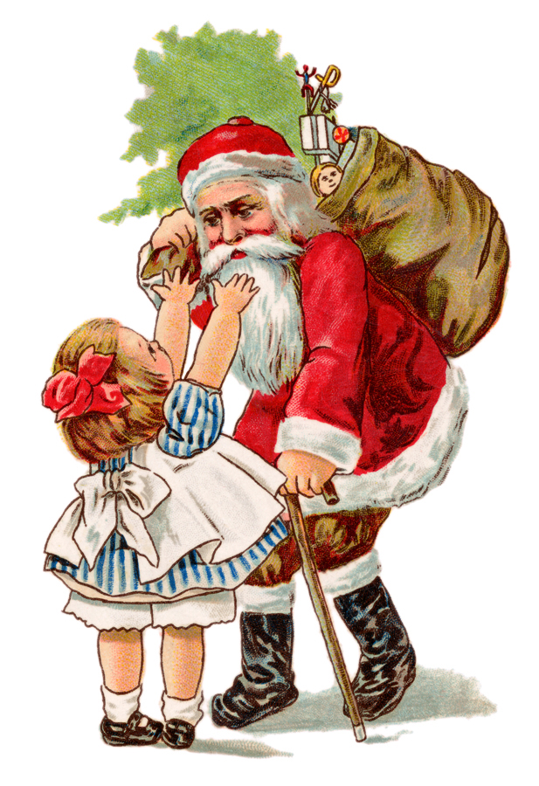
All About Me
Cambria
THE FAT GUY IS NOT ME… : )

Slide 2
My Family
Dad (Thomas)
Mom(Janelle)
Tene’
T.J.
Michael
Josiah
Emily
Joel
Me( Cambria)
Adia
Sela
Jordan
Rhema
Malaki
Cat( Meow-Meow/Starbucks)
Cat(Oreo)
Dog(Buddy)

Slide 3
My Friends
Friends
Hannah 1
Hannah 2
Zoe
Hannah 3
Hailey
Patti
Daniel
Myra
Michael
Kaylie
Angel
Rebecca
Andria
Dori
Jordan
Rachel
Makayla
Sean
Jared
Marquise
Debinique
Samara
Trey
Amana
Miranda
I have more than I thought I did : )
DO NOT READ
TOO MANY

Slide 4
About Me
Colors | Music Artist’s | Sports | Things to do | People
Aqua Blue | Skillet | Basketball | Biking | Mom
Neon Green | Decyfer Down | Bowling | Read | Dad
Black | Paramore | Football | Listen to music | Teachers
Any Dark or Neon Color :) | Demi Lovato | Baseball | Get outside the house | Friends
Facts
I’m 12
Birthday is 11,08,97
I’m AWESOME!!!
More facts
I have 12 brothers and sisters( including me)
My dad is in the military.
My mom is crazy. Thats a fact : )

Slide 5
Likes and Dislikes
Category | Likes | Dislikes
Food | Mashed Potatoes | Peanuts. I'm allergic.
Sports | Bowling | Croquet. BORING!!!
Animals | Cats | Great White Sharks : (
Movies | Pirates of the Carribean1,2,& 3 | Old Yeller (HATE IT!!!) I don’t like any animal movies

Slide 6
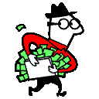



If I won a million dollars
I would…..
Give some to friends and family
Buy whatever I want
Pay all my mom and dads bills
Save my money, just in case
Help by donating to charities

Slide 7


The best/worst meals I’ve ever had
Best | Worst
Thanksgiving with dad and family 2007 | Some kind of nasty “spaghetti” with squash instead of noodles I puked after that ; )

Slide 8
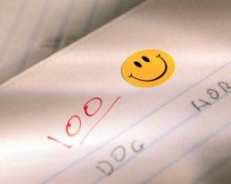
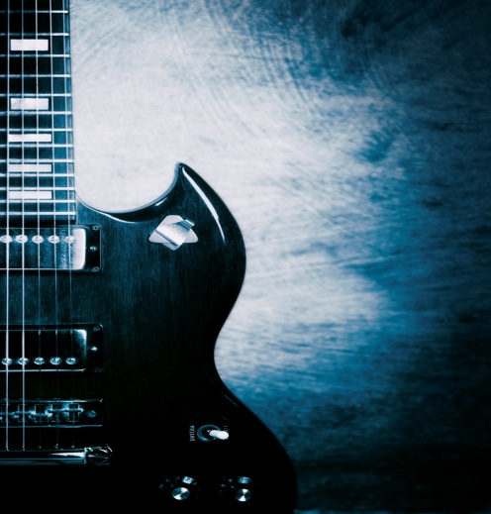
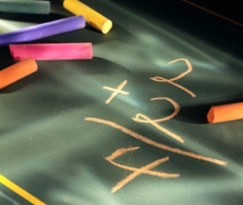
The best/worst gift I’ve ever gotten
The Best
Electric Guitar
Snowboard
Mix Max
Mp3 Player
The Worst
Socks
Stickers
A Kids Sing-Along CD
Chalk

Slide 9
Jobs I might try one day
A fashion designer
A computer lab teacher
A Librarian
A Model
But Wait There’s More!!!

Slide 10
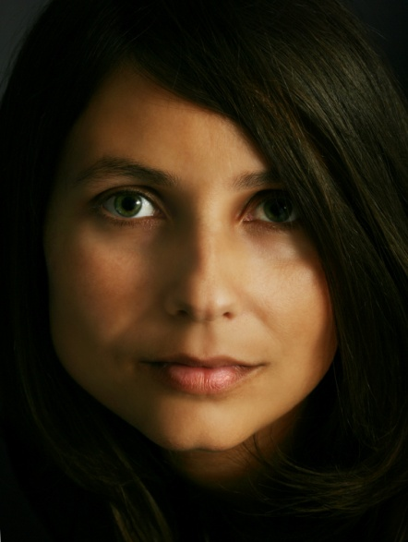
Jobs I might try one day….Continued…: )
A Hairstylist
An Actress
A Mom
An Ice Sculpture
Photographer
My hair would look like this
I WOULD LOOK LIKE THIS

Slide 11



Superpowers I wish I had
A FAT SUPERMAN ; )
I wish I could…..
Be invisible
Fly
Could remember everything
HAHA FAT MAN FLYING : )

Slide 12
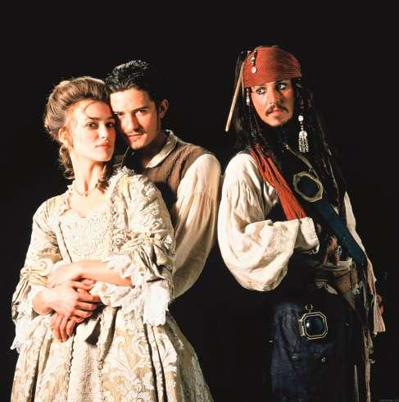


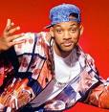
My favorite actors
Keira Knightly
Anne Hathaway
Orlando Bloom
Johnny Depp
Fran Dreschure
Will Smith

Slide 13




My Favorite Authors
Meg Cabot
Ted Dekker
Frank Peretti
Hailey De’Marco

Slide 14
My favorite places
California | Kansas | Theme Parks | Places | Stores
San Pedro | Wichita | Knott's Berry Farm | My Aunt Jenny’s house | Wal-Mart
Rosamond | Haven't been | Disneyland | School | Any Mall
Long Beach | Here That | Six Flags | Fort Mac Arthur AFB | Claires
Ventura | Long. |  | Aquarium of the Pacific Long Beach, CA | Barnes and Noble book store

Slide 15

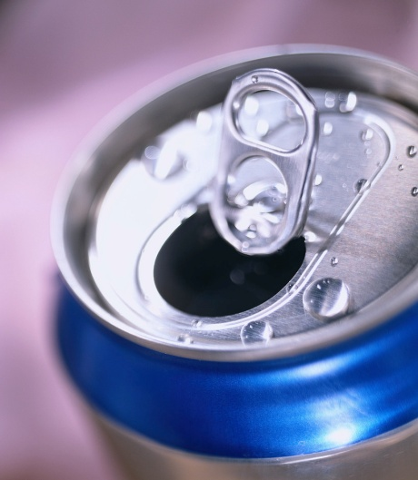
My Favorite Soda’s
Dr. Pepper
Coca-
Any type of root beer
Pepsi
Sprite
Mountain Dew
Soda experiments

Slide 16



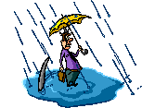




Things I’m afraid of
Spiders
Sharks
My mom
Some Dogs

Slide 17

My Best and Worst grades
Best
A+++ in everything else
Worst
D. : ( in Science But I got my grade changed to an A…WHOO HOO!!!

Slide 18
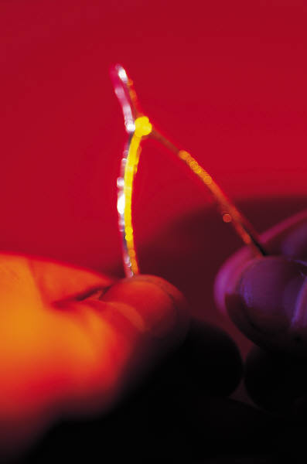
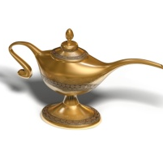
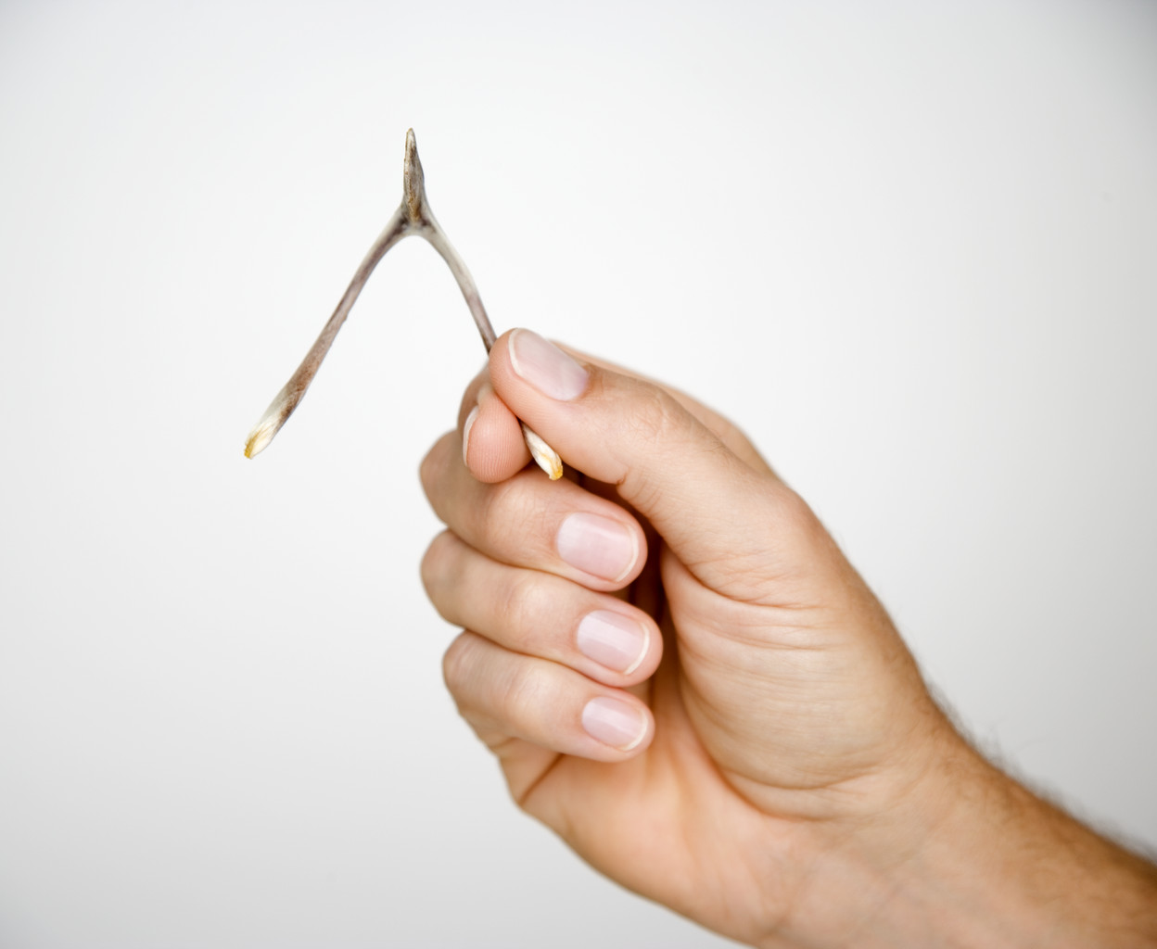
Wishes I would like to come true
To have a million more wishes
Everything would be free for only me
That I could have $$$a million dollars$$$

Slide 19

All the great things about me
I’m AWESOME!!!
I’m nice and friendly
I try to get good grades
I like to have fun
I try to be respectful
AND I’M STILL AWESOME: )

Slide 20
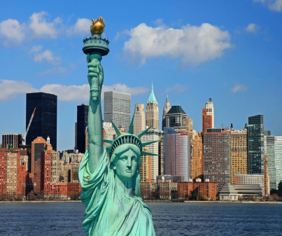
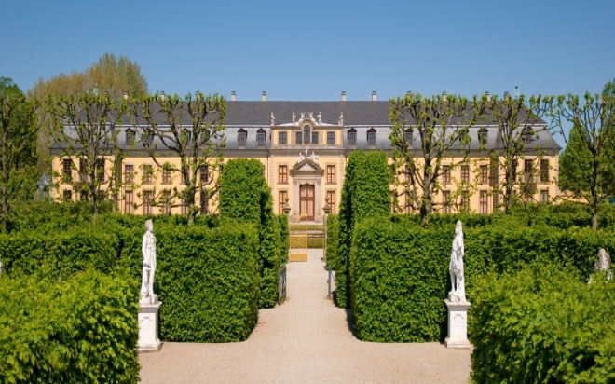
Places I would like to go
Europe
Asia
New York
California ( My Home)

Slide 21
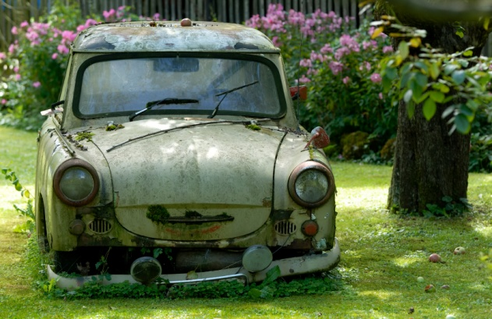
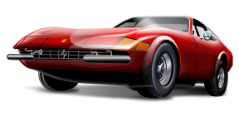
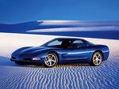
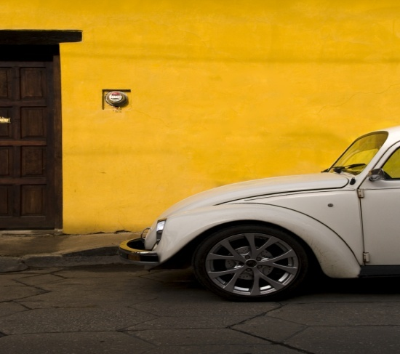
My favorite type of car
ROAD TRIP!!!…
NOT : )
Buggy’s
Corvette’s
Are
These
Awesome

Slide 22




Some of my favorite people
Abraham Lincoln
My Mom
My Dad
Some Teachers**Mrs. Powell**
Some Friends Do I get an A now???

Slide 23
My Quotes
There’s no cure for AWESOMENESS!!!
Thus with a kiss I die(fave line from a movie)
I know right(ikr)
Ikr
(I know right)

Slide 24

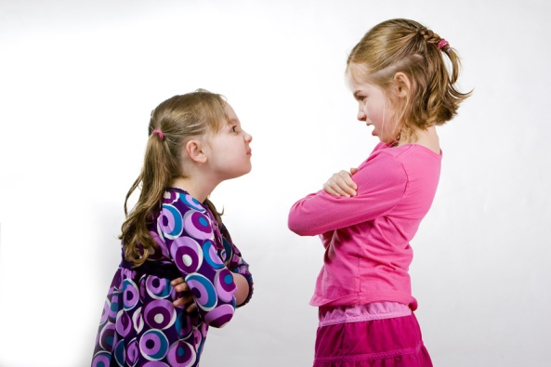
My Job Status
Business: | Family Worker
Boss: | Mom, Dad
Job: | Big Sis
Work: | Work hard, be bossy, change diapers
Pay: | Allowance, and my own room
Employed Since: | The time I was born 11,08,97,,, till now

Slide 25
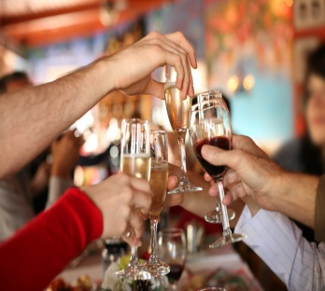
How I describe me
Funny(most of the time)
Random
Weird
Lazy
Social
Mature
Confusing, very confusing…

Slide 26
My Shapes
pod
nano

Slide 27
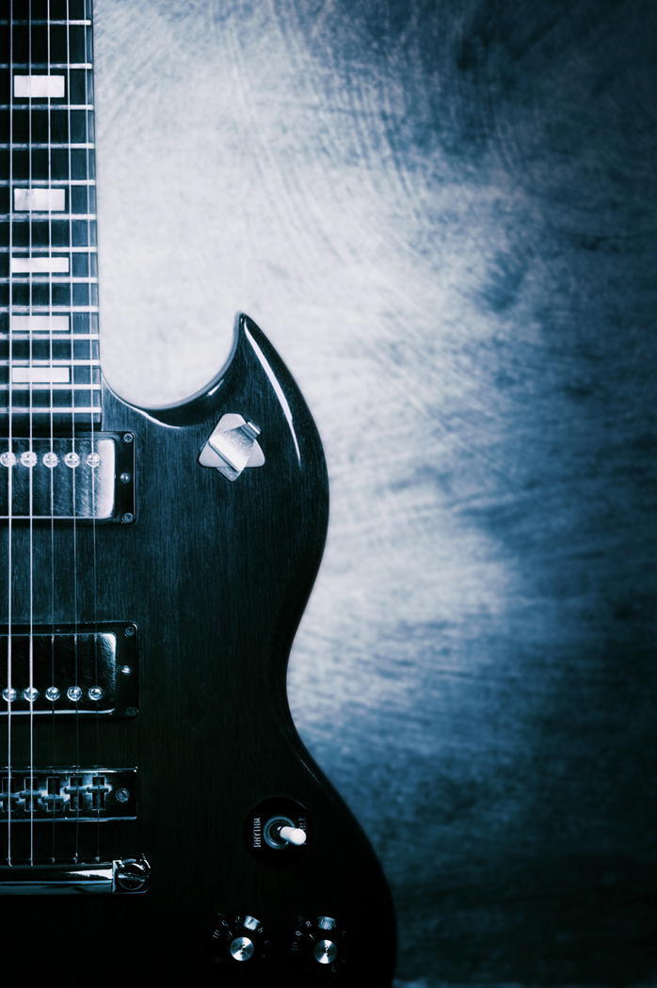
Clip Art
THIS IS AWESOME!!
: )

Slide 28

The End
Thank you to everyone

