Slide 1
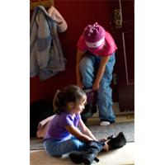


Teaching Self-Help Skills
Within An Inclusive Early Childhood Classroom

Slide 2
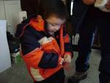
Benefits of Self-Help Skills
Teaching self-help skills in the classroom promotes self-esteem, creates independence and enhances fine motor skills. Children will be using hands on experience to manipulate objects
Teaching self-help skills to children with special needs, helps them integrate into a regular classroom setting where they can encounter wonderful learning experiences among peers
Many children with disabilities are visual learners so working with real tangible objects provides the best possible learning outcomes

Slide 3
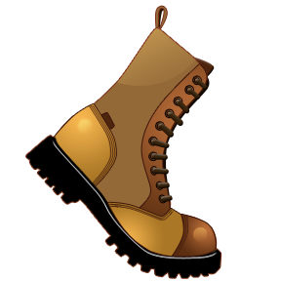
Today we are going to learn how to become big boys and girls and do things for ourselves independently and as a team. We are going to learn how to put on our coats and mittens for when we go outside and play in the cold weather. We will also learn how to put on boots correctly and learn how to
manipulate buttons, snaps
and zippers.

Slide 4
Motivate the Children with A Rhyme and Demonstrate the Procedure First
My coat is open on the floor
I sit at the tip-top
In the armholes go one hand then the other
Then it's over my head-flip-flop

Slide 5
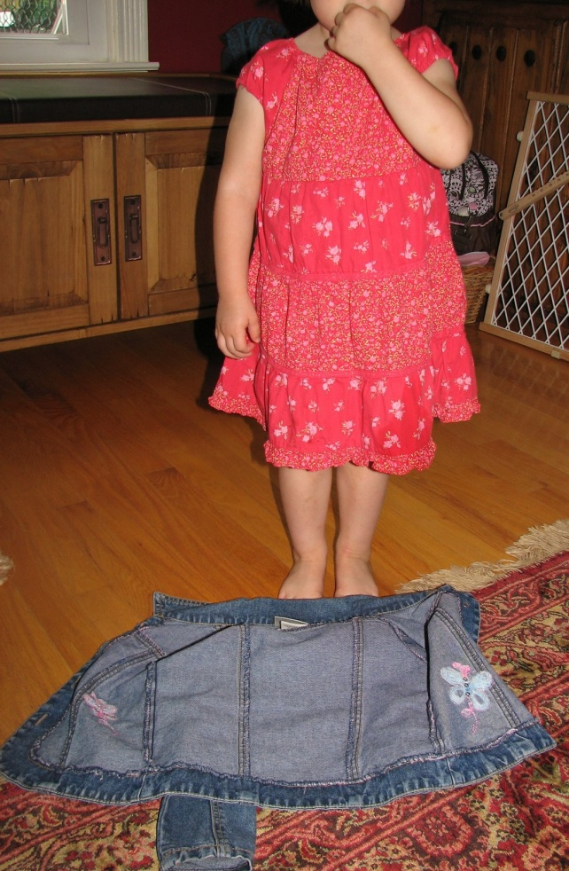
Lets Begin With Learning How to Put on Our Coat
Step1
Have all the children
meet on the rug and
show them how to place
the coat on the floor with
the open end facing up,
sleeves spread out
and the neck part of
the coat closest to our
bodies
“My coat is open on the floor”

Slide 6
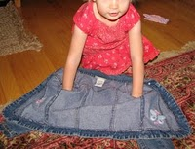
Step 2
Squat down near the neck of the coat, and slip arms inside the arm holes
“I sit at the tip-top”
“In the armholes go one hand then the other”

Slide 7
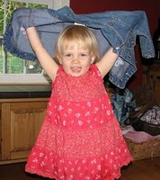
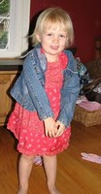

STEP 3
Then lift your arms up and over your head, the coat will slide down your arms and around you
Then it's over my head-flip, flop

Slide 8
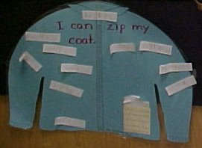
Motivating Chart
I Can Zip My Coat
Encourage and keep track of students as they learn to
zip their coats
Make a coat out of construction paper
When a student is able to demonstrate the ability to zip his or her coat, the child or teacher can write his or her name on a slip of paper and tape it to the chart.

Slide 9
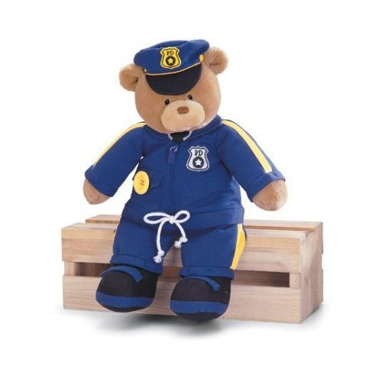
Through play, young children learn about themselves and the world around them. Children discover how things work during play and develop a sense of competency (Dunlap, 2009 p. 353)
Playing Dress Up With A Bear

Slide 10
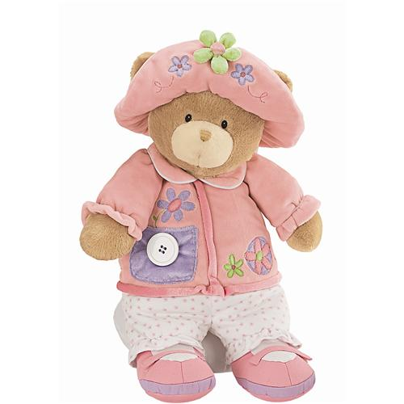
Playing Dress Up with a Bear
Dressing up a teddy bear or a doll is another
motivating way to teach children how to
dress themselves. This activity teaches fine motor
skills, finger dexterity, eye-hand coordination as
well as adaptive skills. Children can learn how to
use their hands to grasp, pinch and squeeze in order
to zip, button, buckle and tie.
Teaches children what to wear during different seasons and it helps identify important community members such as police officers and fireman.
Encourage Dramatic play by creating a dress up center in your classroom. Provide clothing similar to the bear such as shorts, light dresses, gloves, coats, sweaters, scarves, thick socks and hats and ask them to dress up for a particular season.
For children with disabilities purchase an oversized bear that wears children sized clothing. This allows children who have poor motor skills the ability to easily manipulate zippers , snaps, buttons, Velcro & laces.

Slide 11
How to Put on Your Mittens with A Partner
Motivate Children by starting off with an Action Song that creates movement and team work within the classroom
Winter Pokey (Hokey-Pokey)
You put your right mitten in, You take your right mitten out.
You put your right mitten in, and you shake it all about. You do the winter pokey, [shiver] And you turn yourself around. That's what it's all about!
Notes:
You can create other verses such as: You put your left mitten in....You put your right boot....You put your left boot....

Slide 12
How to Put on Your Mittens with a Partner
Have partner (1) hold the mitten on the palm of their hand with the opening facing the child putting on the mitten.
Have partner (2) whose putting on the gloves to slide their palm inside.
To motivate the children, tell them that when they are sliding on the gloves the tips of their fingers have to touch the other persons nose.

Slide 13
Teaching Children with Special Needs How to Put on Boots Using Hand-Over-Hand Method
Put your hand on top of the child’s hand and move over their whole foot so they feel and understand the shape of their foot.
Have the child feel the inside and outside of a slip on shoe.
To put the shoe on, guide the child’s hands to the shoe and, using the hand-over-hand method, slide the shoe onto the child’s foot. This enables the child to feel the entire task of putting on their shoe, it also aids in the development of motor memory.

Slide 14
Teaching Children Which Shoe Goes on What Foot
Have your children trace their feet, cut them out & glue onto a thick piece of cardboard. Place the Letters L & R on the left & right foot. Every time a child’s confused, they can place their cardboard copy of their feet on the floor to guide them.
Place a sticker inside their shoes
showing the left and right foot
You can also peg together boots in the correct order with clothespins
R
L

Slide 15

Reinforce What Was Learned
Reinforce these skills throughout the day, as students put on and take off coats, mittens and shoes
Always give praise for their efforts

