Slide 1
In the Fog Milton Geiger
Notes:
1

Slide 2
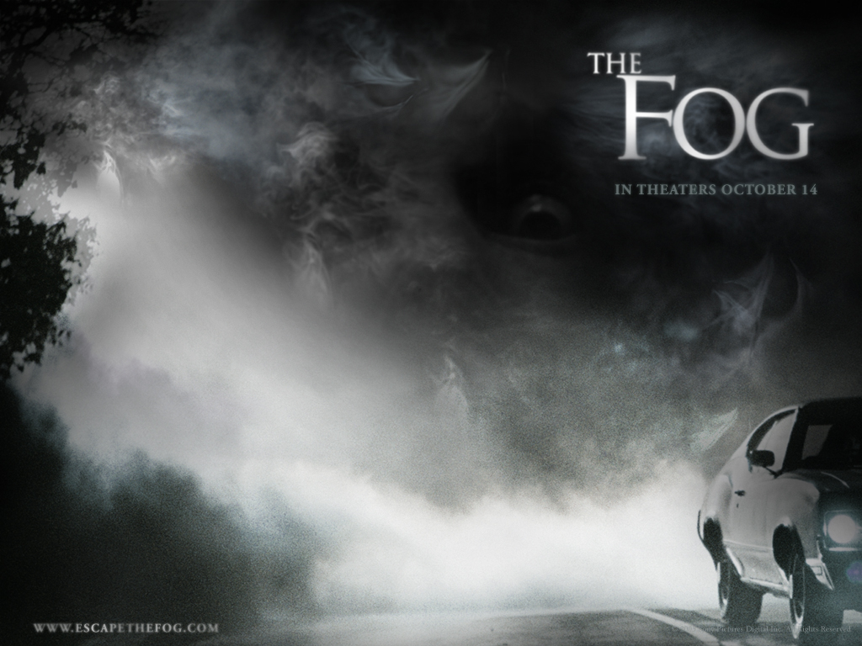
Movies made on similar themes

Slide 3
What is the play about?
‘In the Fog’ is about a doctor driving through Pennsylvania who is stopped by two ghosts named Eben and Zeke who need their (ghost) friend to be healed by him. The Doctor does so and goes to tell a man at the gas station, but the man says he sees them all the time.

Slide 4
Who are the three ghosts in the play?
There are three ghosts in the drama. Two are named while the third is not. The two named ones are Eben and Zeke. The third is their wounded comrade whose name is not revealed.
Notes:
4

Slide 5
SETTING: ‘In the Fog’ takes place in the hills of Pennsylvania, next to the Gettysburg graveyard. This is where "the Doctor" first meets Eben and Zeke, two ghosts of the men who fought at Gettysburg.
Notes:
5

Slide 6
What events occur in the play?
A doctor is lost in the fog while driving somewhere in Pennsylvania. Two strange men (Zeke and Eben) force the doctor at gunpoint into the woods to help a wounded friend. The doctor treats the man and insists that the men take him to a hospital, but the men refuse. Later, a gas station attendant tells the doctor the men had taken him to “Gettysburg” and that the men have stopped others
before too on nights like this.

Slide 7
What are the relationships between the characters?
The doctor and the gas station
attendant have no relationship with the other characters. Zeke and Eben appear to be the ghosts of soldiers who served together at the Battle of Gettysburg.

Slide 8
What mood is set by the dialogue and the setting?
(in the stage directions)
The fog and darkness, the men forcing the doctor to go into the woods, and the men’s indirect answers to the doctor’s questions create an eerie and mysterious mood.

Slide 9
What is the theme of the drama? Responses will vary. Students may say that the theme is that “Things may not always be what they appear to be.” or otherwise…
Notes:
9

Slide 10
What events are caused by earlier events?
The doctor getting lost in the fog causes him to be near the woods where the men confront him. The soldier being wounded in battle causes the men to request the doctor’s help. The gas station attendant telling the doctor that he was near the
graveyard of the Battle of Gettysburg causes the doctor to suspect that the men
may be ghosts.

Slide 11
Hypothetical Question for students!
How would I stage this drama as a live performance?
Expected Response: To stage the play as a live performance would require four actors and three sets made to look like a road in the fog, a rock or stump in the woods, and a gas station. It would also be desirable to create some kind of steam or smoke to look like fog.

Slide 12
Power Point Presentation By Ms. Rachel Sylvia Creativity Private School. Bahrain
Notes:
12

